Slide 1

AMC ENGINEERING COLLEGE
Department of Computer Science and Engineering
CLASSIFICATION OF UTERINE FIBROID MEDICINES REVIEWS USING MACHINE LEARNING MODEL
Presented by,
Syed Ashfaq (1AM15CS194)
Vijay k (1AM15CS212)
Junaid Ahmed (1AM15CS223)
Sachin Kumar S (1AM16CS405)
Under the guidance of,
Ms. Vineeta
Assistant Professor
Dept of CSE

Slide 2
Contents
Introduction
Literature survey
Problem definition
Proposed solution
Hardware Requirements
Software Requirements
System Architecture
Methodology
Definition of SVM
How it Works?
Information of Output
Result of SVM
KNN(K Nearest Neighbor)
Naïve Bayes

Slide 3
INTRODUCTION
AIM:
Predicting best drug based on reviews given by user using SVM algorithm.

Slide 4
ABSTRACT:
Uterine fibroids are noncancerous growths of the uterus that often appear during childbearing years. Also called leiomyomas (lie-o-my-O-muhs) or myomas, uterine fibroids aren't associated with an increased risk of uterine cancer and almost never develop into cancer.
The Medicines required to cure Uterine Fibroid Cancer are Leuprolide, Lupron, Ulipristal.
Prevention technique Healthy lifestyle choices, such as maintaining a normal weight and eating fruits and vegetables, you may be able to decrease your fibroid risk.
Also, some research suggests that using hormonal contraceptives may be associated with a lower risk of fibroids.

Slide 5
LITERATURE SURVEY TABLE
SL .NO | TITLE | AUTHOR | YEAR | ADVANTAGE | DISADVANTAGE | METHODOLOGY
1. | Classification of drugs reviews using W-LRSVM Model | Venugopal KR | 2015 | Accuracy 97.25 for 1700 positive and 1700 negative reviews | 2700 positive and 2700 negative reviews accuracy is decreases
2. | Sentiment classification for Chinese reviews: A comparison between SVM and semantic approaches | Qiang YE, | 2014 | Accuracy 78.87 | Totally 142 reviews 71 positive and 71 negative.

Slide 6
PROBLEM DEFINITION
Classifying user reviews of the uterine fibroid medicines into set of positive or negative based on ratings given by user.

Slide 7
PROPOSED SOLUTION
We have proposed a model to in which the drug reviews are crawled from the web and classified drug reviews as positive or negative.
We are using a dataset of drug reviews using machine learning.
We are using SVM, KNN and Naïve Bayes algorithms.
A user interface is designed which helps patients and medical professionals in analyzing the results for a particular drug.

Slide 8
HARDWARE REQUIREMENTS
Processor : Intel i7
Hard Disk : 50 Gb Free
Ram : 16 Gb Minimum (32 Preferred)
GPU : Any GPU that is compatible with OpenGL 3.2.
(NVIDIA GTX 1060 Preferred)
Any desktop / Laptop system with above configuration or higher level

Slide 9
SOFTWARE REQUIREMENTS
Operating system -Windows 7,8,10
Python 3.7 and Pre installed Libraries

Slide 10
SYSTEM ARCHITECTURE
Drugs.com
Everydayhealth.com
Webmd.com
Review collection
DATASET
PREPROCESSING DATASET
CLASSIFIER USED
VALIDATING DATASET
Performance analysis

Slide 11
METHODOLOGY
By using Web Scraping tool we will extract the reviews of users and classify the reviews based on positive or negative.
Applying machine learning algorithm we will get which medicine is best.

Slide 12
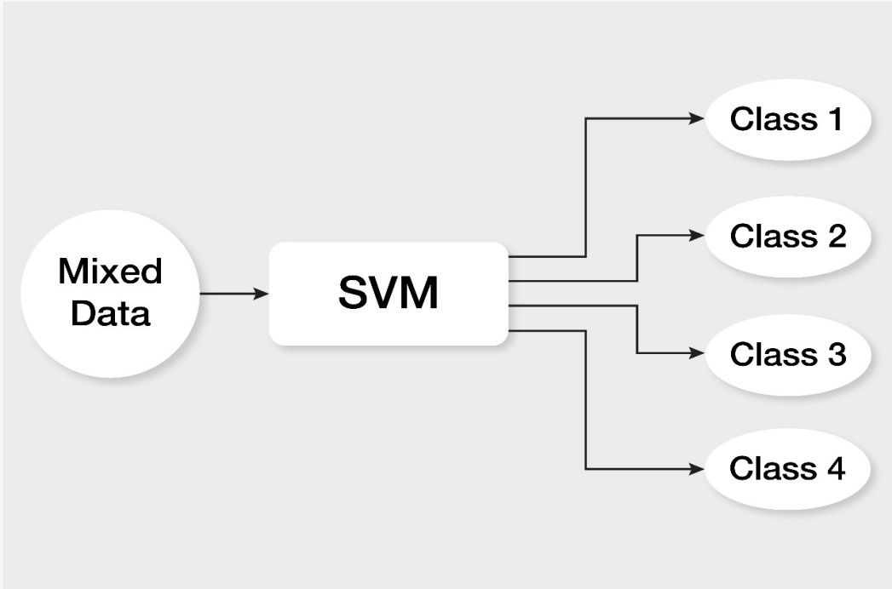
SVM(support vector machine)
A support vector machine (SVM) is machine learning algorithm that analyzes data for classification and regression analysis.
SVM is a supervised learning method that looks at data and sorts it into one of two categories.

Slide 13
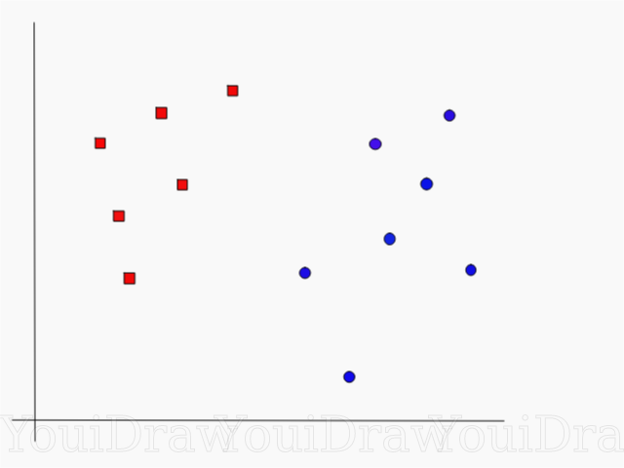
How It Works
Suppose you have a dataset as shown below and you need to classify the red rectangles from the blue ellipses(let’s say positives from the negatives). So your task is to find an ideal line that separates this dataset in two classes (say red and blue).

Slide 14
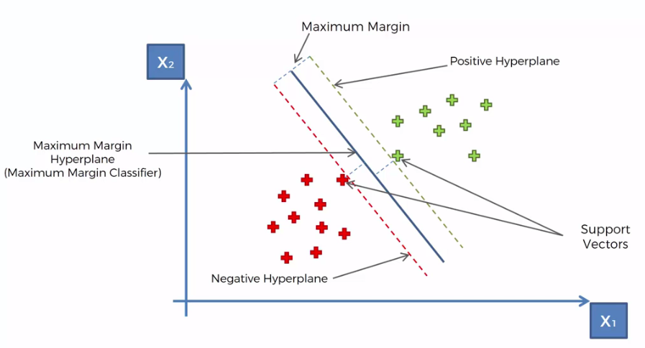
How Does SVM Find Best Line?
According to the SVM algorithm we find the points closest to the line from both the classes. These points are called support vectors. Now, we compute the distance between the line and the support vectors. This distance is called the margin. Our goal is to maximize the margin. The hyperplane for which the margin is maximum is the optimal hyperplane.

Slide 15
How SVM Calculates Result?
In the above project we have 3 medicines i.e. Lupron,
Traxemic acid and Ulipristal.
Based on the comments given by user we have classified
It has positive and negative reviews or neutral.
We have extra column sentiment i.e. If we have review rating is greater than 5 then sentiment will be 1 and if less then sentiment will be 0.
Finally It finds accuracy and tell us the best drug using SVM algorithm.

Slide 16
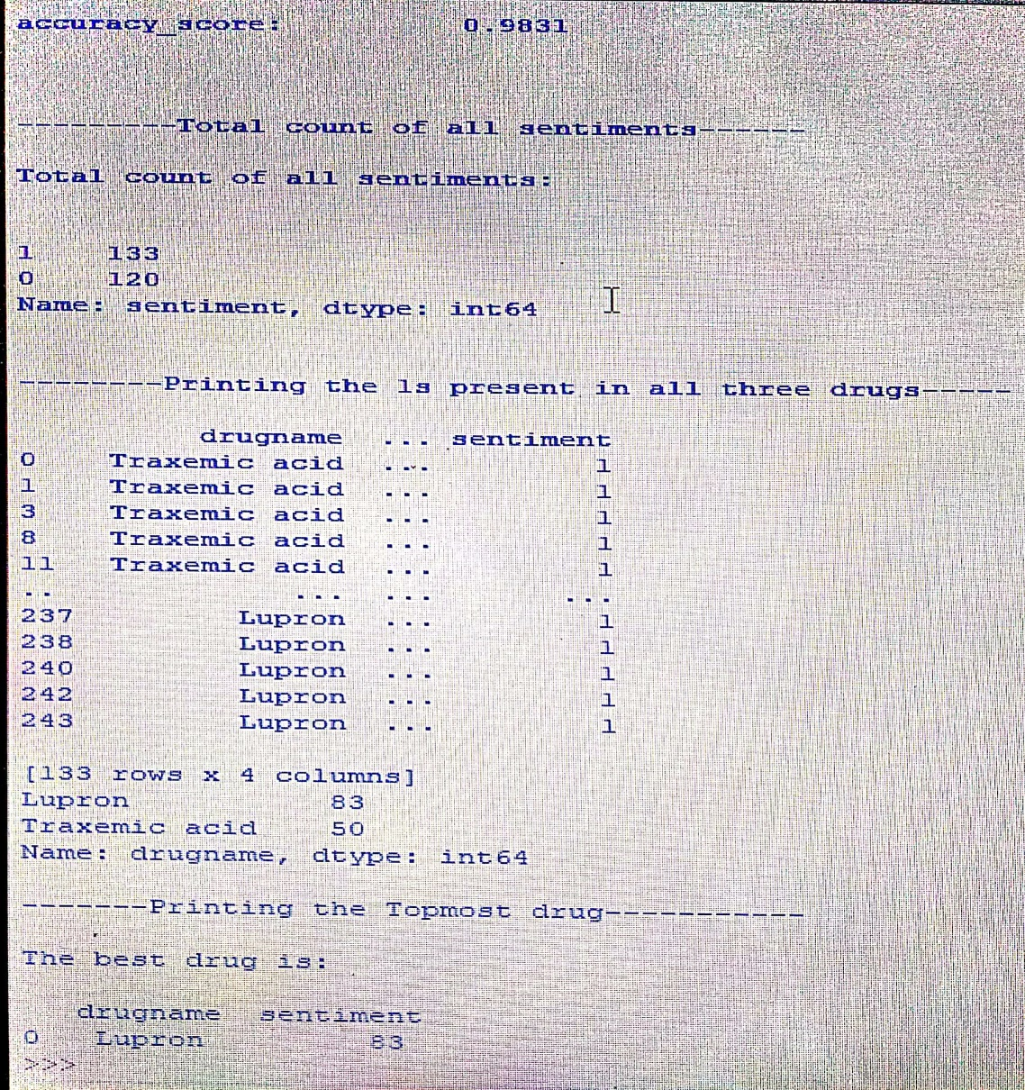
Output of SVM

Slide 17
KNN(K-Nearest Neighbors)
K-Nearest Neighbour is one of the simplest Machine Learning algorithms based on Supervised Learning technique.
K-NN algorithm can be used for Regression as well as for Classification but mostly it is used for the Classification problems.

Slide 18
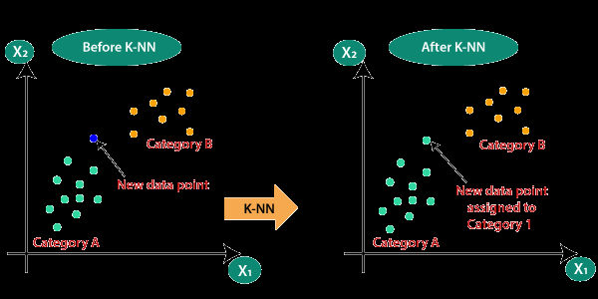
Why We Need KNN?
By calculating the Euclidean distance we got the nearest neighbors, as three nearest neighbors in category A and two nearest neighbors in category B.
EuclianDistance = √(x2 – x1)² + (y2 – y1)²

Slide 19
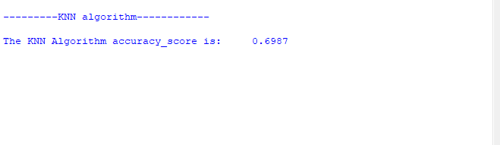
Output Obtained For KNN

Slide 20
Naïve Bayes Classifier
Naïve Bayes algorithm is a supervised learning algorithm, which is based on Bayes theorem and used for solving classification problems.
P(A|B)=P(B|A)P(A)/P(B)
P(A|B) is Posterior probability: Probability of hypothesis A on the observed event B.
P(A) is Prior Probability: Probability of hypothesis before observing the evidence.
P(B) is Marginal Probability: Probability of Evidence.

Slide 21
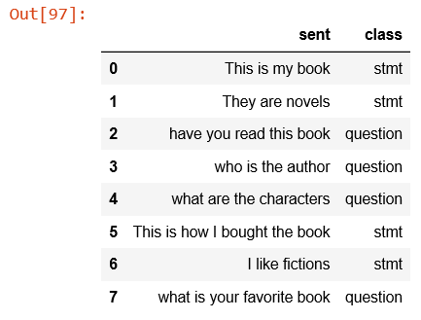
Aim Of Naïve Bayes Classifier
It is mainly used in text classification that includes a high-dimensional training dataset.

Slide 22
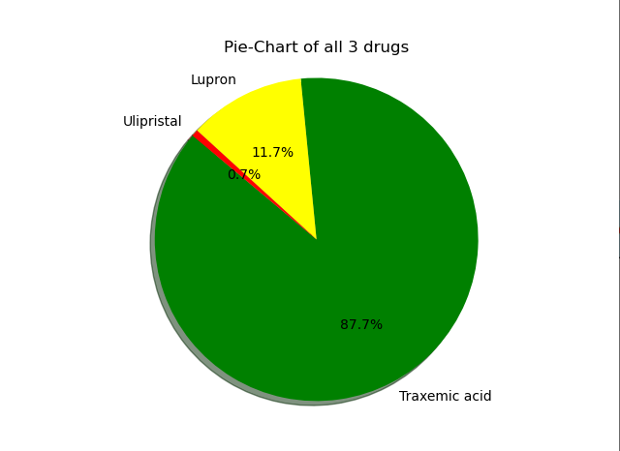

Slide 23
CONCLUSION
By using machine learning algorithm we classify reviews
and tell which is best medicine.

Slide 24
REFERENCES
Asha S Manek, Pallavi R P, Veena H Bhat, P Deepa Shenoy, Venugopal K R, M Chandramohan, L M Patnaik, “ SentRep: Sentiment Classification of Movie Reviews using Efficient Repetitive Pre- Processing”, International Conference IEEE TENCON 2013, 22-25October 2013, Xi’an China,, ISBN No. 978-1-4799-2825-5, pp. 1-5.
Liu, Xiao, and Hsinchun Chen. “AZDrugMiner: an information extraction system for mining patient-reported adverse drug events in online patient forums” Smart Health. Springer Berlin Heidelberg, 2013. pp 134-150.
Han-Xiao Shi and Xiao-Jun Li :A sentiment analysis model for hotel reviews based on supervised learning.

Slide 25
THANK YOU

